Slide 1
Construction of character table
C2h point group
Dr.N.Rexin Alphonse

Slide 2
Characteristics of C2h point group
The order of the C2h point group is 4,and the order of the principal axis(C2)is 2.The group has four irreducible representations.
The C2h point group is isomorphic to C2v and D2, and also to the kleenex four-group
The C2h point group is generated by two two symmetry elements,C2 and i;non-canonically,by C2 and sigma ‘h’ or by I and sigma ‘h’.
The lowest nonvanishing multipole moment in C2h is 4(Quadrupole moment).
This is an Abeilan point group(the commutative law holds between all symmetry operations).

Slide 3
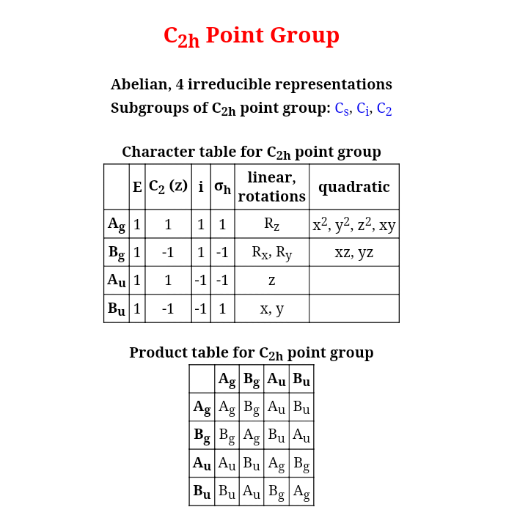
Character table of C2h point group

Slide 4
The C2h point group
The C2h group is Abeilan because it meets two sufficient conditions.Its symmetry elements are coaxial,and none is of its order is 3 or higher.
In Abeilan groups,all symmetry operations form a class of their own,and all irreducible representations are one-dimensional.
There are no symmetry elements of an order higher than 2 in this group.The symmetry-adapted cartesain products in the table above are needlessly complicated;rather,anyc simple product will do.

Slide 5
The C2h point group
All characters are integers because the order of the principal axis is 1,2,3,4 or 6.Such point groups are also referred to as “crystallographic point groups”,as they are compatible with periodic lattice symmetry.
There are exactly 32 such groups:C1,Cs,Ci,C2,C2h,C2v,C3,C3h,C3v,C4,C4h,C4v,C6,C6h,C6v,D2,D2d,D2h,D3,D3d,D3h,D4,D4h,D6,D6h,

Slide 6
Subgroups in C2h point group
The crystallographic notation(Hermann-Mauguin system)of the C2h point group is 2/m.
The C2h symmetry is exemplified by a parallelogram or the shape of the letter S.
The C2h group has three nontrivial subgroups:C2,Cs,Ci. Each of them appears in only one orientation,which is also the standard orientation for that group.
The C2h group itself is a subgroup of C2nh(one orientation),D2nh(three orientation),D(2n+1)d(one orientation)and the isomeric groups Th,Ih(both one orientation)and Oh(two orientations).

Slide 7
Examples
Molecules with C2h symmetry are very common.Some examples include butane,hexane,trans-1,2-dichloroethene,ethanediol,trans-2-butene,1,3-butadiene,oxalic acid,2,2’-bipyridine,butadione,1,4-dibromo-2,5-dichlorobenzene,trans-decalin(bicyclo(4.4.0)decane),zethrene,etc.,

Slide 8
Character table of C2h point group
The different symmetry Operation are E,C2,sigma ‘h’,i= order= 4 There are 4 classes of operation there should be 4 irreducible representation T1,T2,T3,T4.Then sum of the squares of the dimensions should be 4.
The dimension has to be an integer there should be one dimensional representation.
For any point group there should be IRR,which is symmetrical to all the operation.So that the character table corresponding to all the operator is 1 IRR.
The characters of other IRR we must apply the orthogonality function.The characters of the IRR, are orthogonal to each other,we know the identity operation operation for T2 IRR is 1.

Slide 9
Equation
The characters of C3 and the character of sigma ‘v’ for T2 such that 1.1.1+1.1.Xc2+1.1.Xh+1.1.Xi=0
Only if character of C2=-1,character of i=1 and character of sigma’h’=-1. The above equation can be correct.
The characters of T3 should be orthogonal to T1 and T2.Let the character of identity operation is 1.
Considering T1 and T3,
1.1.1+1.1.X’C2+1.1.X’i+1.1.X’h=0

Slide 10
Values of X’
Considering T2 and T3
1.1.1+1.(-1).X’C2+1.1.X’i+1.(-1).X’h=0
By equating the above equation.we get,
x’i=-1
The condition satisfied only if,
X’C2=1 and X’h=-1

